Slide 1





OOP Basic Topics
Classes, Fields, Constructors, Methods, Properties
SoftUni Team
Technical Trainers
Software University
http://softuni.bg

Slide 2

Table of Contents
Defining Simple Classes
Fields, Constructors, Methods, Properties
Access Modifiers
Keeping the Object State
Exceptions
Generic Classes
Attributes
Interfaces

Slide 3
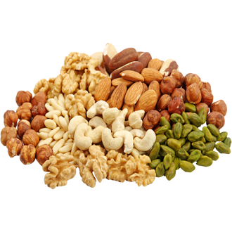
Defining Simple Classes

Slide 4
Classes in OOP
Classes model real-world objects and define:
Attributes (state, properties, fields)
Behavior (methods, operations)
Classes describe the structure of objects
Objects describe particular instance of a class
Properties hold information about the modeled object relevant to the problem
Operations implement object behavior

Slide 5
Classes in C#
Classes in C# can have members:
Fields, constants, methods, properties, indexers, events, operators, constructors, destructors, …
Inner types (inner classes, structures, interfaces, delegates, ...)
Members can have access modifiers (scope)
public, private, protected, internal
Members can be
static (common) or specific for a given object (per instance)

Slide 6

Simple Class Definition
Beginning of class definition
public class Cat : Animal {
private string name;
public Cat(string name, string owner)
{
this.Name = name;
this.Owner = owner;
}
public string Name
{
get { return this.name; }
set { this.name = value; }
}
Inherited (base) class
Field
Constructor
Property

Slide 7
Simple Class Definition (2)
public string Owner
{
get;
set;
}
public void SayMiau()
{
Console.WriteLine("Miauuuuuuu!");
}
}
Automatic Property
Method
End of class definition

Slide 8
Class Definition and Members
Class definition consists of:
Class declaration
Inherited class and implemented interfaces
Fields (static or not)
Constructors (static or not)
Properties (static or not)
Methods (static or not)
Events, inner types, etc.

Slide 9
Fields
Fields are data members defined inside a class
Fields hold the internal object state
Can be static or per instance
Can be private / public / protected / …
class Dog
{
private string name;
private string breed;
private int age;
protected Color color;
}
Field declarations

Slide 10
Constant Fields
Constant fields are of two types:
Compile-time constants – const
Replaced by their value during the compilation
Runtime constants – readonly
Assigned once only at object creation
class Math
{
public const float PI = 3.14159;
public readonly Color = Color.FromRGBA(25, 33, 74, 128);
}

Slide 11
Constant Fields – Example
public class Constants
{
public const double PI = 3.1415926535897932385;
public readonly double Size;
public Constants(int size)
{
this.Size = size; // Cannot be further modified!
}
static void Main()
{
Console.WriteLine(Constants.PI);
Constants c = new Constants(5);
Console.WriteLine(c.Size);
c.Size = 10; // Compilation error: readonly field
Console.WriteLine(Constants.Size); // Compilation error: non-static field
}
}

Slide 12
Access Modifiers
Class members can have access modifiers
Used to restrict the access from the other classes
Supports the OOP principle "encapsulation"
Class members can be:
public – accessible from any class
protected – accessible from the class itself and all its descendants
private – accessible from the class itself only
internal (default) – accessible from the current assembly, i.e. the current Visual Studio project

Slide 13
The "this" Keyword
The keyword this points to the current instance of the class
Example:
class Dog
{
private string name;
public void PrintName()
{
Console.WriteLine(this.name);
// The same like Console.WriteLine(name);
}
}

Slide 14
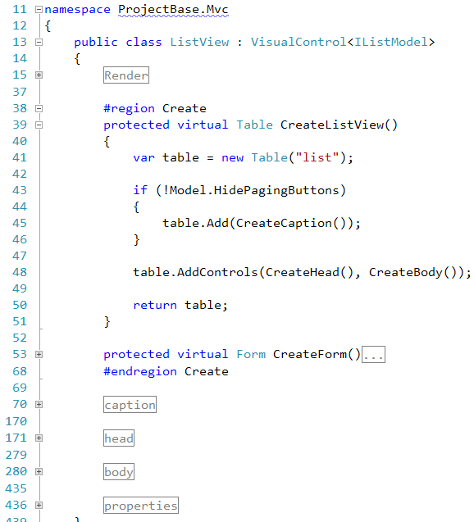

Using Classes and Objects

Slide 15
Dog Meeting – Example
static void Main()
{
Console.Write("Enter first dog's name: ");
string dogName = Console.ReadLine();
Console.Write("Enter first dog's breed: ");
string dogBreed = Console.ReadLine();
// Use the Dog constructor to assign name and breed
Dog firstDog = new Dog(dogName, dogBreed);
// Use Dog's parameterless constructor
Dog secondDog = new Dog();
// Use properties to assign name and breed
Console.Write("Enter second dog's name: ");
secondDog.Name = Console.ReadLine();
Console.Write("Enter second dog's breed: ");
secondDog.Breed = Console.ReadLine(); (the example continues)

Slide 16
Dog Meeting – Example (2)
// Create a Dog with no name and breed
Dog thirdDog = new Dog();
// Save the dogs in an array
Dog[] dogs = new Dog[] { firstDog, secondDog, thirdDog };
// Ask each of the dogs to bark
foreach (Dog dog in dogs)
{
dog.SayBau();
}
}

Slide 17

Dog Meeting
Live Demo

Slide 18

Constructors
Defining and Using Class Constructors

Slide 19
What is Constructor?
Constructors are special methods
Invoked at the time of creating a new instance of an object
Used to initialize the fields of the instance
Constructors have the same name as the class
Have no return type
Can have parameters
Can be private, protected, internal, public

Slide 20

Defining Constructors
Class Point with parameterless constructor:
public class Point
{
private int xCoord;
private int yCoord;
// Simple parameterless constructor
public Point()
{
this.xCoord = 0;
this.yCoord = 0;
}
// More code …
}

Slide 21
Defining Constructors (2)
public class Person
{
private string name;
private int age;
// Parameterless constructor
public Person()
{
this.name = null;
this.age = 0;
}
// Constructor with parameters
public Person(string name, int age)
{
this.name = name;
this.age = age;
}
// More code …
}
As a rule constructors should initialize all class fields

Slide 22
Constructors and Initialization
Pay attention when using inline initialization!
public class AlarmClock
{
private int hours = 9; // Inline initialization
private int minutes = 0; // Inline initialization
// Parameterless constructor (intentionally left empty)
public AlarmClock()
{ }
// Constructor with parameters
public AlarmClock(int hours, int minutes)
{
this.hours = hours; // Invoked after the inline
this.minutes = minutes; // initialization!
}
// More code …
}

Slide 23

Chaining Constructors Calls
Reusing the constructors (chaining)
public class Point
{
private int xCoord;
private int yCoord;
public Point() : this(0, 0) // Reuse the constructor
{
}
public Point(int xCoord, int yCoord)
{
this.xCoord = xCoord;
this.yCoord = yCoord;
}
// More code …
}

Slide 24

Constructors
Live Demo

Slide 25
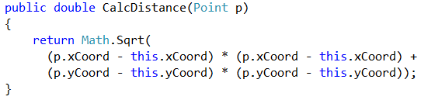


Methods
Defining and Invoking Methods

Slide 26
Methods
Methods execute some action (some code / some algorithm)
Could be static / per instance
Could be public / private / protected / …
public class Point
{
private int xCoord;
private int yCoord;
public double CalcDistance(Point p)
{
return Math.Sqrt(
(p.xCoord - this.xCoord) * (p.xCoord - this.xCoord) +
(p.yCoord - this.yCoord) * (p.yCoord - this.yCoord));
}
}

Slide 27
Using Methods
Invoking instance methods is done through the object (through the class instance):
class TestMethods
{
static void Main()
{
Point p1 = new Point(2, 3);
Point p2 = new Point(3, 4);
System.Console.WriteLine(p1.CalcDistance(p2));
}
}

Slide 28
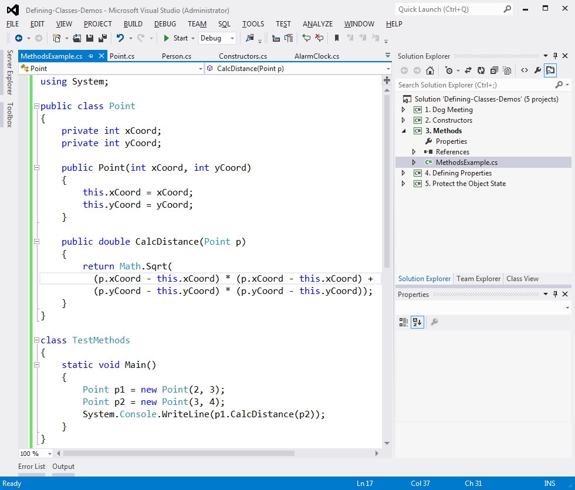
Methods
Live Demo

Slide 29
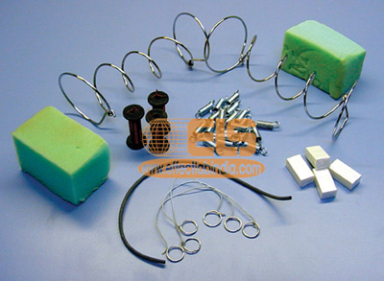
Properties
Defining and Using Properties

Slide 30

Why We Need Properties?
Properties expose object's data to the world
Control how the data is accessed / manipulated
Ensure the internal object state is correct
E.g. price should always be kept positive
Properties can be:
Read-only
Write-only
Read and write

Slide 31
Defining Properties
Properties work as a pair of get / set methods
Getter and setter
Properties should have:
Access modifier (public, protected, etc.)
Return type
Unique name
Get and / or Set part
Can process data in specific way, e.g. apply validation

Slide 32
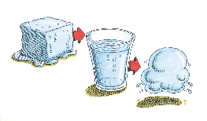
Defining Properties – Example
public class Point
{
private int xCoord;
private int yCoord;
public int XCoord
{
get { return this.xCoord; }
set { this.xCoord = value; }
}
public int YCoord
{
get { return this.yCoord; }
set { this.yCoord = value; }
}
// More code …
}

Slide 33
Dynamic Properties
Properties are not always bound to a class field
Can be dynamically calculated:
public class Rectangle
{
private double width;
private double height;
public double Area
{
get
{
return width * height;
}
}
}

Slide 34
Automatic Properties
Properties could be defined without an underlying field
They are automatically created by the compiler (auto properties)
class UserProfile
{
public int UserId { get; set; }
public string FirstName { get; set; }
public string LastName { get; set; }
}
…
UserProfile profile = new UserProfile() {
FirstName = "Steve",
LastName = "Balmer",
UserId = 91112
};

Slide 35

Properties
Live Demo

Slide 36




Keeping the Object State Correct

Slide 37
Keep the Object State Correct
Constructors and properties can keep the object's state correct
This is known as encapsulation in OOP
Can force validation when creating / modifying the object's internal state
Constructors define which properties are mandatory and which are optional
Property setters should validate the new value before saving it in the object field
Invalid values should cause an exception

Slide 38
Keep the Object State – Example
public class Person
{
private string name;
public Person(string name)
{
this.Name = name;
}
public string Name
{
get { return this.name; }
set
{
if (string.IsNullOrEmpty(value))
throw new ArgumentException("Invalid name!");
this.name = value;
}
}
}
We have only one constructor, so we cannot create a person without specifying a name
Incorrect name cannot be assigned

Slide 39
Keeping the Object State Correct
Live Demo

Slide 40

What are Exceptions?
The Paradigm of Exceptions in OOP

Slide 41
What are Exceptions?
The exceptions in .NET Framework / Java are a classic implementation of the OOP exception model
Deliver powerful mechanism for centralized handling of errors and unusual events
Substitute procedure-oriented approach, in which each function returns error code
Simplify code construction and maintenance
Allow the problematic situations to be processed at multiple levels

Slide 42

Handling Exceptions
Catching and Processing Errors

Slide 43

Handling Exceptions
In C# exceptions can be handled by the try-catch-finally construction
catch blocks can be used multiple times to process different exception types
try
{
// Do some work that can raise an exception
}
catch (SomeException)
{
// Handle the caught exception
}

Slide 44

Handling Exceptions – Example
static void Main()
{
string s = Console.ReadLine();
try
{
int.Parse(s);
Console.WriteLine(
"You entered a valid Int32 number {0}.", s);
}
catch (FormatException)
{
Console.WriteLine("Invalid integer number!");
}
catch (OverflowException)
{
Console.WriteLine(
"The number is too big to fit in Int32!");
}
}

Slide 45
Exception Hierarchy in .NET
Exceptions in .NET Framework are organized in a hierarchy

Slide 46
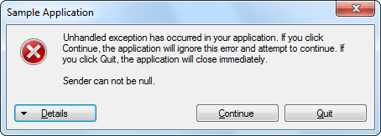
How Do Exceptions Work?
5. Throw an exception
Method N
Method N
…
4. Method call
…
6. Find handler
Method 2
Method 2
3. Method call
7. Find handler
Method 1
Method 1
2. Method call
8. Find handler
Main()
Main()
.NET CLR
1. Execute the
program
9. Find handler
10. Display error message

Slide 47

Call Stack Example
Live Demo

Slide 48

Generic Classes
Parameterizing Classes

Slide 49
What are Generics?
Generics allow defining parameterized classes that process data of unknown (generic) type
The class is instantiated (specialized) with different particular types
Example: List<T> → List<int> / List<string> / List<DateTime> / List<Student>
Generics are known as "parameterized types" or "template types"
Similar to the templates in C++
Similar to the generics in Java

Slide 50
Generic Class – Example
T is an unknown type, parameter of the class
public class GenericList<T>
{
public void Add(T element) { … }
}
class GenericListExample
{
static void Main()
{
// Declare a list of type int
GenericList<int> intList =
new GenericList<int>();
// Declare a list of type string
GenericList<string> stringList =
new GenericList<string>();
}
}
T can be used in any method in the class
T can be replaced with int during the instantiation

Slide 51
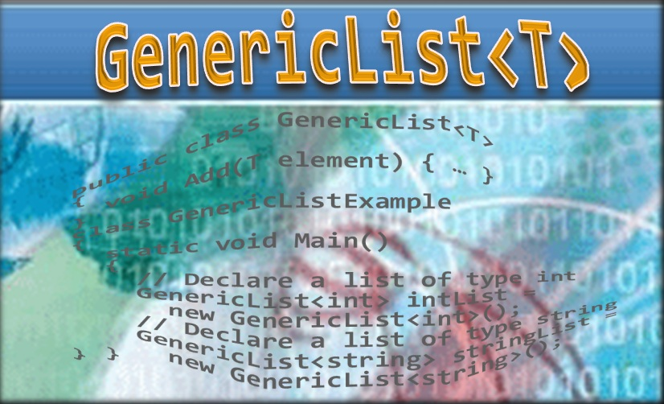
Generic Classes
Live Demo

Slide 52

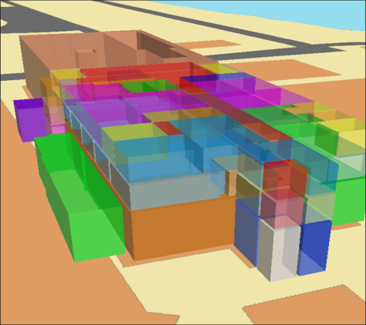
Attributes
Applying Attributes to Code Elements

Slide 53
What are Attributes?
.NET attributes are:
Declarative tags for attaching descriptive information in the declarations in the code
Saved in the assembly at compile time
Objects derived from System.Attribute
Can be accessed at runtime (through reflection) and manipulated by many tools
Developers can define custom attributes

Slide 54
Custom Attributes – Example
[AttributeUsage(AttributeTargets.Property)]
public class MinAttribute : System.Attribute
{
public int MinValue { get; private set; }
public MinAttribute(int minValue)
{
this.MinValue = minValue;
}
}
// Example continues
public class Book
{
public Book(string title, int copies)
{
this.Title = title;
this.Copies = copies;
}
public string Title { get; set; }
[MinAttribute(0)]
public int Copies { get; set; }
}

Slide 55
Custom Attributes – Example (2)
var book = new Book("Pod Igoto", 1);
var properties = book.GetType().GetProperties();
foreach (var property in properties)
{
foreach (var attribute in property.GetCustomAttributes(false))
{
if (attribute is MinAttribute)
{
var minAttribute = (MinAttribute) attribute;
int minValue = minAttribute.MinValue;
int actualValue = (int) property.GetValue(book);
if (actualValue < minValue)
{
throw new ArgumentOutOfRangeException("Copies cannot be less than 0");
}
}
}
}

Slide 56
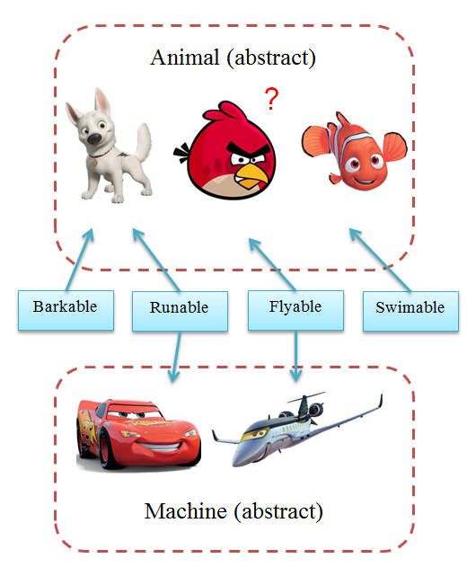
Interfaces – Example
Classes
Interfaces

Slide 57
Interfaces in C#
Interfaces in C# describe a prototype of group of methods (operations), properties and events
Can be implemented by a class or structure
Define only the signature of the methods / properties
No concrete implementations are provided
Can be used to define abstract data types
Can be inherited (extended) by other interfaces
Cannot be instantiated

Slide 58
Interfaces – Example
public class JsonFormatter : IFormatter
{
public string Format(string name)
{
return "{\"name\":\" + name + "{0}\"}",
}
}
Classes can implement multiple interfaces
public interface IFormatter
{
string Format(string name);
}
public class FilePrinter
{
public void Print(IFormatter formatter)
{
string formatted = formatter.Format("pesho");
File.WriteAllText(formatted);
}
}
public class XmlFormatter : IFormatter
{
public string Format(string name)
{
return "<name>" + name + "</name>";
}
}

Slide 59

License
This course (slides, examples, demos, videos, homework, etc.) is licensed under the "Creative Commons Attribution-NonCommercial-ShareAlike 4.0 International" license
Attribution: this work may contain portions from
"Fundamentals of Computer Programming with C#" book by Svetlin Nakov & Co. under CC-BY-SA license
"OOP" course by Telerik Academy under CC-BY-NC-SA license

Slide 60









OOP Basic Topics
https://softuni.bg/courses/oop

Slide 61





Free Trainings @ Software University
Software University Foundation – softuni.org
Software University – High-Quality Education, Profession and Job for Software Developers
softuni.bg
Software University @ Facebook
facebook.com/SoftwareUniversity
Software University @ YouTube
youtube.com/SoftwareUniversity
Software University Forums – forum.softuni.bg

